Slide 1
Chapter 5
Computer Systems Organization

Slide 2
Learning Objectives (1 of 2)
Enumerate the characteristics of the Von Neumann architecture
Describe the components of a random access memory system, including how fetch and store operations work, and the use of cache memory to speed up access time
Diagram the components of a typical arithmetic/logic unit (ALU) and illustrate how the ALU data path operates

Slide 3
Learning Objectives (2 of 2)
Describe the operation of the control unit and explain how it implements the stored program characteristic of the Von Neumann architecture
List and explain the types of instructions in a typical instruction set, and how instructions are commonly encoded
Diagram the organization of a typical Von Neumann machine
Show the sequence of steps, using the book’s notation, in the fetch, decode, and execute cycle to perform a typical instruction

Slide 4
Introduction (1 of 2)
This chapter changes the level of abstraction and focuses on a higher level of computer system construction
Focus on functional units and computer organization
A hierarchy of abstractions hides unnecessary details
Change focus from transistors to gates and to circuits as the basic unit
Discusses in detail the Von Neumann architecture

Slide 5
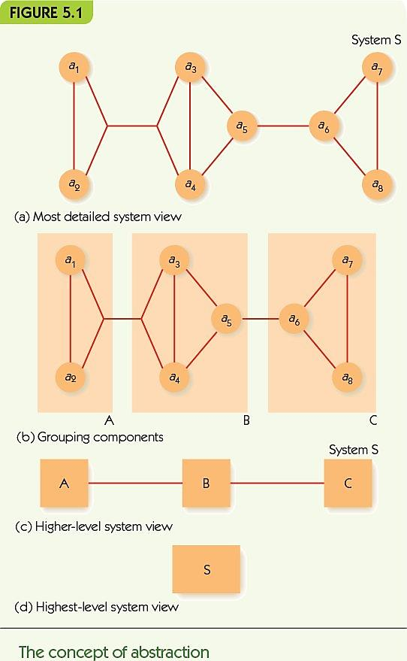
Introduction (2 of 2)

Slide 6
The Components of a Computer System (1 of 2)
Von Neumann architecture is the foundation for nearly all modern computers
The four major subsystems of the Von Neumann architecture
Memory
Input/output
Arithmetic/logic unit (ALU)
Control Unit
ALU and control unit are often bundled inside the central processing unit (CPU)

Slide 7
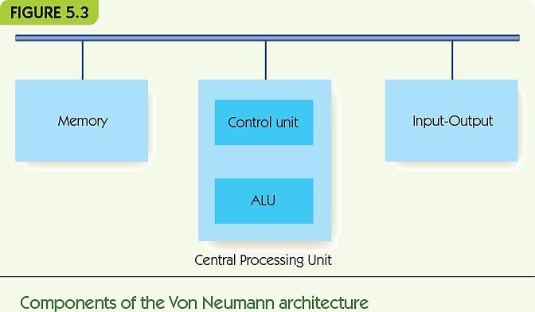
The Components of a Computer System (2 of 2)

Slide 8
The Components of a Computer System Memory and Cache (1 of 9)
Memory: functional unit where data is stored/retrieved
Random access memory (RAM)
Organized into cells, each given a unique address
Equal time to access any cell
Cell values may be read and changed
Read-only memory (ROM): A type of RAM with prerecorded information that cannot be modified or changed
Cell size/memory width is typically 8 bits
Maximum memory size/address space is 2^{N}, where N is length of address

Slide 9
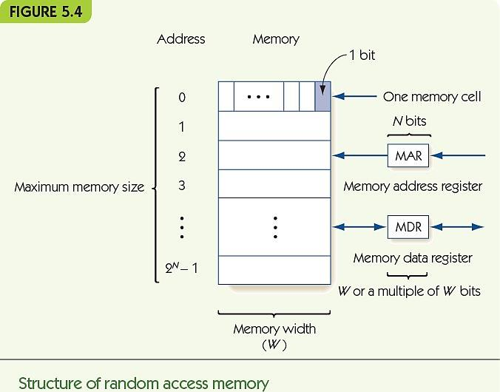
The Components of a Computer System Memory and Cache (2 of 9)

Slide 10
The Components of a Computer System Memory and Cache (3 of 9)
N | Maximum Memory Size (2^{N})
16 | 65,536
20 | 1,048,576
22 | 4,194,304
24 | 16,777,216
32 | 4,294,967,296
40 | 1,099,511,627,776
50 | 1,125,899,906,842,624

Slide 11
The Components of a Computer System Memory and Cache (4 of 9)
Fetch: retrieve from memory (nondestructive fetch)
Store: write to memory (destructive store)
Memory access time
Time required to fetch/store
Modern RAM requires 5-10 nanoseconds
Memory address register (MAR) holds memory address to access
Memory data register (MDR) receives data from fetch and holds data to be stored

Slide 12
The Components of a Computer System Memory and Cache (5 of 9)
Memory system circuits: decoder and fetch/store controller
Decoder converts MAR into signal to a specific memory cell
One-dimensional versus two-dimensional memory organization
Fetch/Store controller ► traffic cop for MDR
Takes in a signal that indicates fetch or store
Routes data flow to/from memory cells and MDR

Slide 13
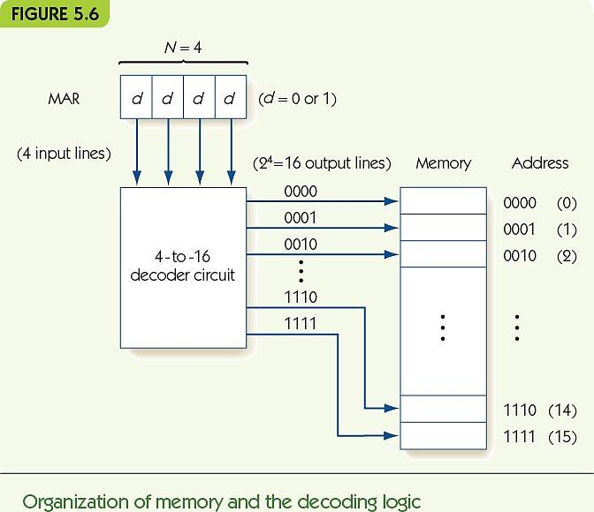
The Components of a Computer System Memory and Cache (6 of 9)

Slide 14
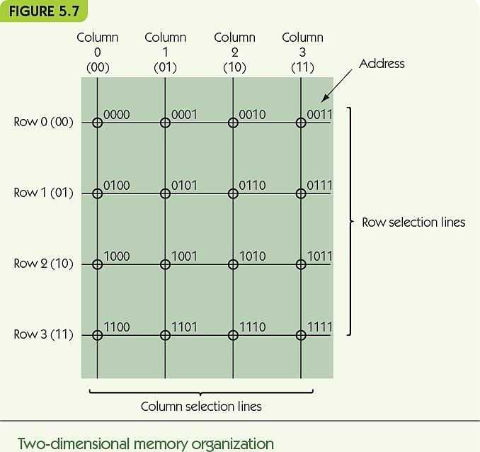
The Components of a Computer System Memory and Cache (7 of 9)

Slide 15
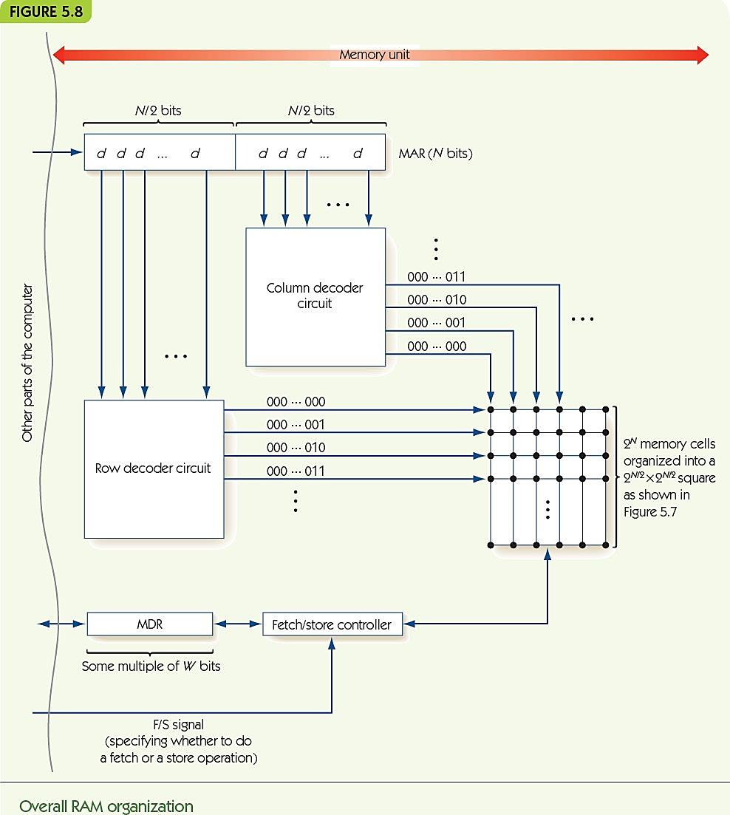
The Components of a Computer System Memory and Cache (8 of 9)

Slide 16
The Components of a Computer System Memory and Cache (9 of 9)
RAM speeds increased more slowly than CPU speeds
Cache memory is fast but expensive
Built into the CPU for fast access times
Principle of locality
Values close to recently accessed memory are more likely to be accessed
Load neighbors into cache and keep recent values there
Cache hit rate: percentage of times values are found in cache

Slide 17
The Components of a Computer System Input/Output and Mass Storage
Input/output (I/O) connects the processor to the outside world
Humans: keyboard, monitor, etc.
Data storage: hard drive, DVD, flash drive
Other computers: network
RAM = volatile memory (gone without power)
Mass storage systems = nonvolatile memory
Direct access storage devices (DASDs)
Sequential access storage devices (SASDs)

Slide 18
The Components of a Computer System I/O and Mass Storage (1 of 6)
DASDs
Disks: Hard drives and optical media (CDs/DVDs)
Tracks: concentric rings around the disk surface
Sectors: fixed size segments of tracks, unit of retrieval
Time to retrieve data based on
Seek time
Latency
Transfer time
Other nondisk DASDs: flash memory and solid-state drives (random access mass storage)

Slide 19
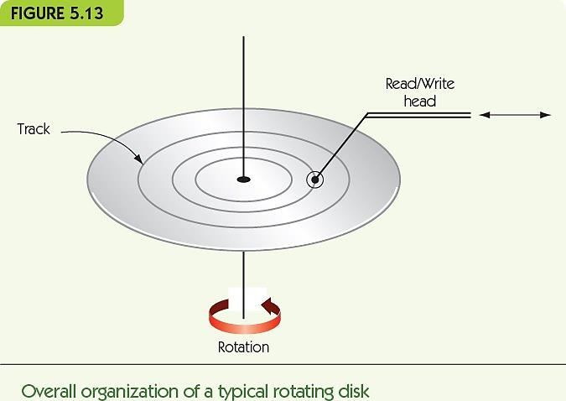
The Components of a Computer System I/O and Mass Storage (2 of 6)

Slide 20
The Components of a Computer System I/O and Mass Storage (3 of 6)
DASDs and SASDs are orders of magnitude slower than RAM: (microseconds or milliseconds).
I/O Controller manages data transfer with slow I/O devices, freeing processor to do other work.
Controller sends an interrupt signal to processor when I/O task is done.

Slide 21
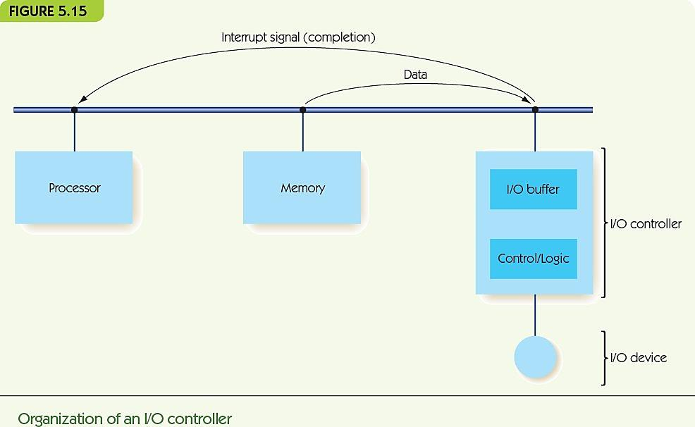
The Components of a Computer System I/O and Mass Storage (4 of 6)

Slide 22
The Components of a Computer System The Arithmetic/Logic Unit
ALU is part of the processor
Contains circuits for arithmetic
Addition, subtraction, multiplication, and division
Contains circuits for comparison and logic
Equality, and, or, not
Contains registers: high-speed, dedicated memory connected to circuits
Data path: how information flows in the ALU
From registers to circuits
From circuits back to registers

Slide 23
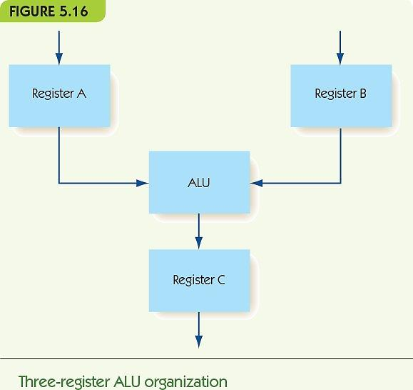
The Components of a Computer System I/O and Mass Storage (5 of 6)

Slide 24
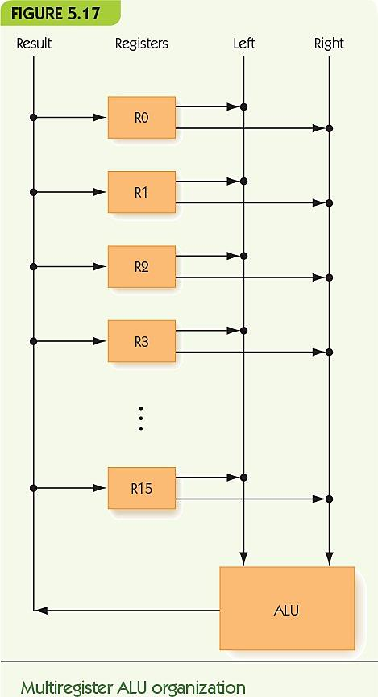
The Components of a Computer System I/O and Mass Storage (6 of 6)

Slide 25
The Components of a Computer System The ALU (1 of 4)
How is the operation to perform chosen?
Option 1: decoder signals one circuit to run.
Option 2: run all circuits, multiplexer selects one output from all circuits.
In practice, option 2 is usually chosen.

Slide 26
The Components of a Computer System The ALU (2 of 4)
Information flow
Data comes in from outside to registers
Signal comes from registers to ALU
Signal moves from ALU to multiplexer
Multiplexer selects the value to keep and discards the rest
Result from the multiplexer goes back to the register and then to outside

Slide 27
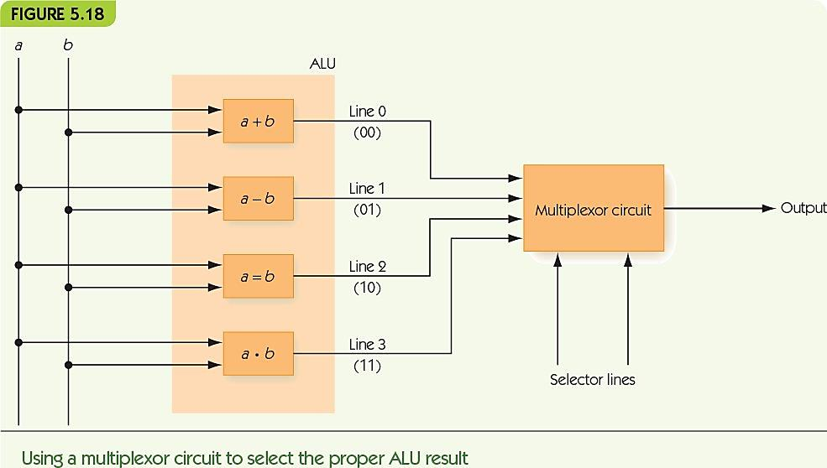
The Components of a Computer System The ALU (3 of 4)

Slide 28
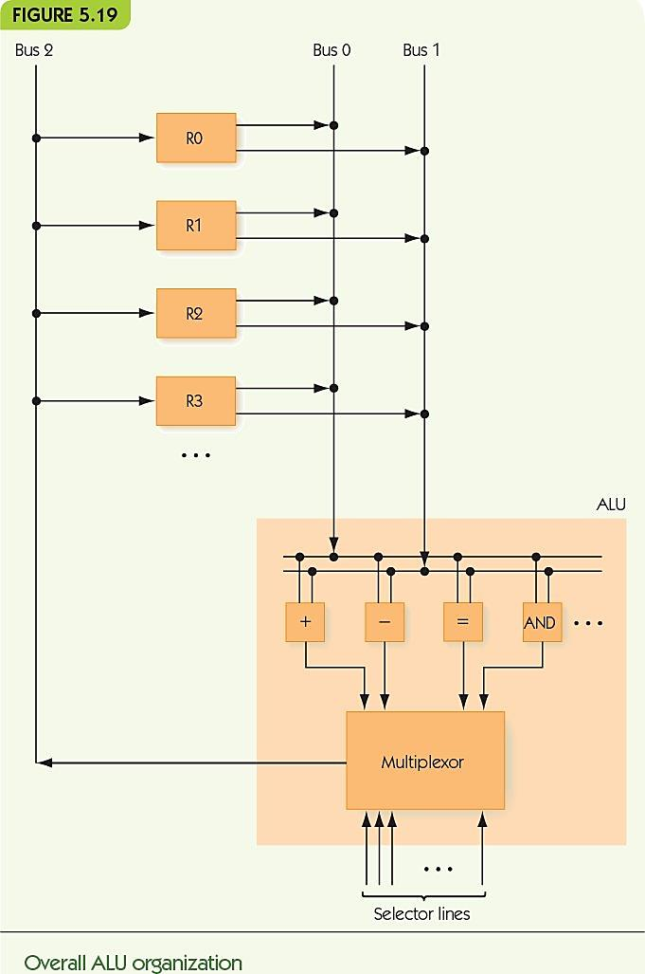
The Components of a Computer System The ALU (4 of 4)

Slide 29
The Components of a Computer System The Control Unit (1 of 9)
Stored program characteristic
Programs are encoded in binary and stored in computer’s memory
Control unit fetches instructions from memory, decodes them, and executes them
Instructions encoded
Operation code (op code) tells which operation
Addresses tell which memory addresses/registers to operate on

Slide 30
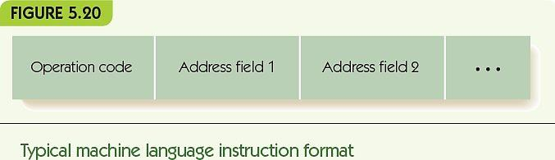
The Components of a Computer System The Control Unit (2 of 9)

Slide 31
The Components of a Computer System The Control Unit (3 of 9)
Machine language
Binary strings encode instructions
Instructions can be carried out by hardware
Sequences of instructions encode algorithms
Instruction set
Instructions implemented by a particular chip
Each kind of processor has a different instruction set (speaks a different language)

Slide 32
The Components of a Computer System The Control Unit (4 of 9)
Reduced instruction set computer (RISC)
Small instruction sets
Each instruction highly optimized
Easy to design hardware
Complex instruction set computer (CISC)
Large instruction set
Single instruction can do a lot of work
Complex to design hardware
Modern hardware is a compromise between RISC and CISC

Slide 33
The Components of a Computer System The Control Unit (5 of 9)
Instruction set examples:
Data transfer, e.g., move data from memory to register
Arithmetic, e.g., add, but also AND
Comparison: compare two values
Branch: change to a nonsequential instruction
Branching allows for conditional and loop forms
E.g., JUMPLT a = If previous comparison of A and B found A < B, then jump to instruction at address a

Slide 34
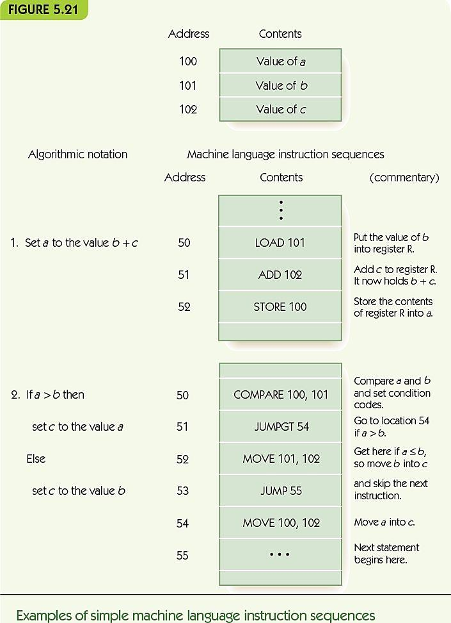
The Components of a Computer System The Control Unit (6 of 9)

Slide 35
The Components of a Computer System The Control Unit (7 of 9)
Control unit contains:
Program counter (PC) register: holds address of next instruction
Instruction register (IR): holds encoding of current instruction
Instruction decoder circuit
Decodes op code of instruction and signals helper circuits, one per instruction
Helpers send addresses to proper circuits
Helpers signal ALU, I/O controller, and memory

Slide 36
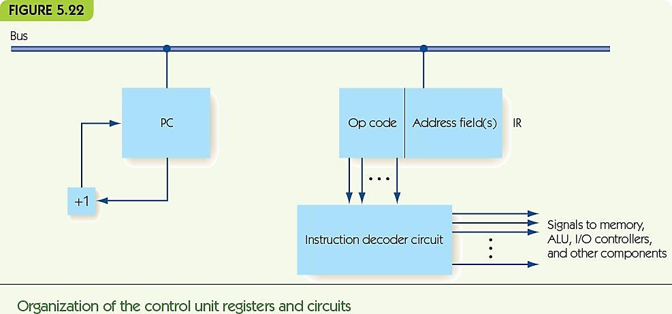
The Components of a Computer System The Control Unit (8 of 9)

Slide 37
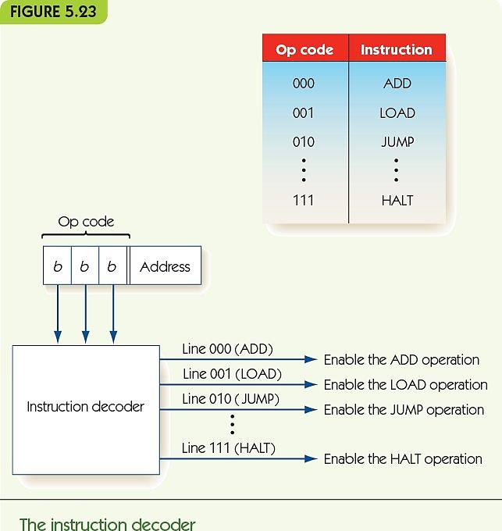
The Components of a Computer System The Control Unit (9 of 9)

Slide 38
Putting the Pieces Together—the Von Neumann Architecture (1 of 9)
Combine previous pieces: Von Neumann machine
Fetch/decode/execute phase
Machine repeats until HALT instruction or error
Also called Von Neumann cycle
Fetch phase: get next instruction into memory
Decode phase: instruction decoder gets op code
Execute phase: different for each instruction

Slide 39
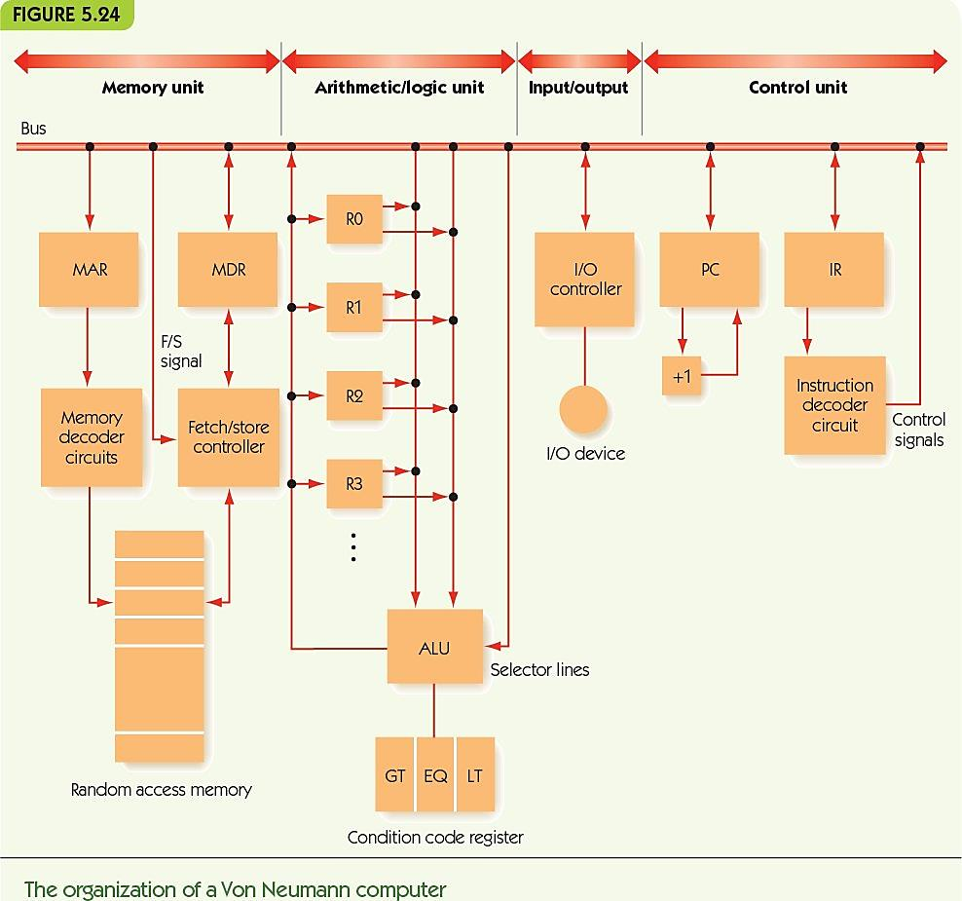
Putting the Pieces Together—the Von Neumann Architecture (2 of 9)

Slide 40
Putting the Pieces Together—the Von Neumann Architecture (3 of 9)
Notation for computer’s behavior
CON(A) | Contents of memory cell A
A → B | Send value in register A to register B (special registers: PC, MAR, MDR, IR, ALU, R, GT, EQ, LT, +1)
FETCH | Initiate a memory fetch operation
STORE | Initiate a memory store operation
ADD | Instruct the ALU to select the output of the adder circuit
SUBTRACT | Instruct the ALU to select the output of the subtract circuit

Slide 41
Putting the Pieces Together—the Von Neumann Architecture (4 of 9)
Fetch phase
PC → MAR Send address in PC to MAR
FETCH Initiate fetch, data to MDR
MDR → IR Move instruction in MDR to IR
PC + 1 → PC Add one to PC
Decode phase
IR_{op} → instruction decoder

Slide 42
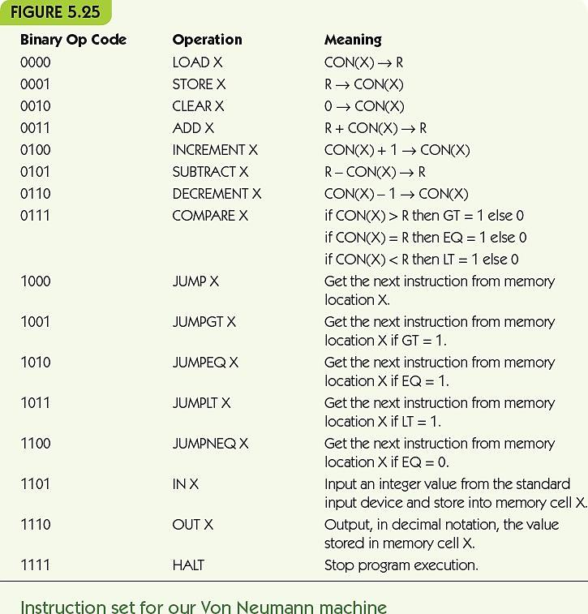
Putting the Pieces Together—the Von Neumann Architecture (5 of 9)

Slide 43
Putting the Pieces Together—the Von Neumann Architecture (6 of 9)
Execution phase
LOAD X meaning CON(X) → R
IR_{addr} → MAR Send address X to MAR
FETCH Initiate fetch, data to MDR
MDR → R Copy data in MDR into R
STORE X meaning R → CON(X)
IR_{addr} → MAR Send address X to MAR
R → MDR Send data in R to MDR
STORE Initiate store of MDR to X

Slide 44
Putting the Pieces Together—the Von Neumann Architecture (7 of 9)
ADD X meaning R + CON(X) → R
IR_{addr} → MAR Send address X to MAR
FETCH Initiate fetch, data to MDR
MDR → ALU Send data in MDR to ALU
R → ALU Send data in R to ALU
ADD Select ADD circuit as result
ALU → R Copy selected result to R
JUMP X meaning get next instruction from X
IR_{addr} → PC Send address X to PC

Slide 45
Putting the Pieces Together—the Von Neumann Architecture (8 of 9)
COMPARE X meaning:
if CON(X) > R, then GT = 1, else 0
if CON(X) = R, then EQ = 1, else 0
if CON(X) < R, then LT = 1, else 0
IR_{addr} → MAR Send address X to MAR
FETCH Initiate fetch, data to MDR
MDR → ALU Send data in MDR to ALU
R → ALU Send data in R to ALU
SUBTRACT Evaluate CON(X) – R
Sets EQ, GT, and LT

Slide 46
Putting the Pieces Together—the Von Neumann Architecture (9 of 9)
JUMPGT X meaning:
if GT = 1, then jump to X,
else continue to next instruction
IF GT = 1 THEN IR_{addr} → PC

Slide 47
Non–Von Neumann Architectures (1 of 6)
Problems to solve are always larger
Computer chip speeds no longer increase exponentially
Reducing size puts gates closer together, faster
Speed of light pertains to signals through wire
Cannot put gates much closer together
Heat production increases too fast
Von Neumann bottleneck: inability of sequential machines to handle larger problems

Slide 48
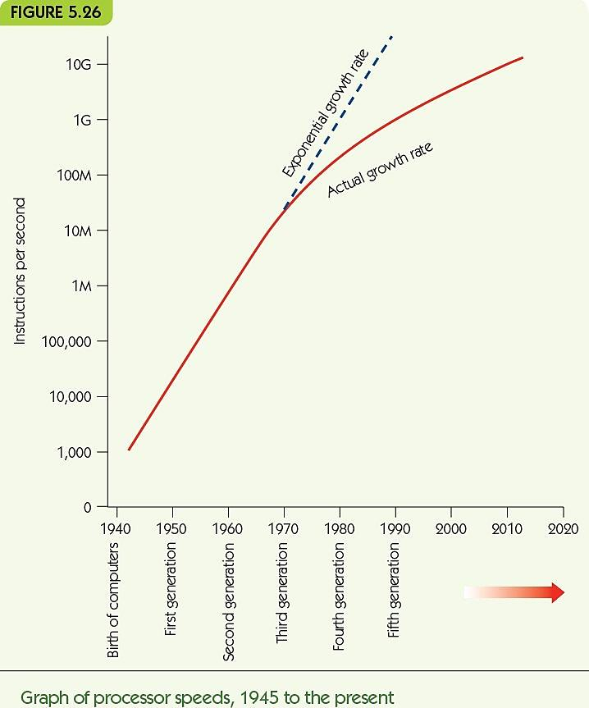
Non–Von Neumann Architectures (2 of 6)

Slide 49
Non–Von Neumann Architectures (3 of 6)
Non–Von Neumann architectures
Other ways to organize computers
Most are experimental/theoretical, EXCEPT parallel processing
Parallel processing
Many processing units operating at the same time
Supercomputers (in the past)
Desktop multicore machines and “the cloud” (in the present)
Quantum computing (in the future)

Slide 50
Non–Von Neumann Architectures (4 of 6)
MIMD parallel processing
Multiple instruction stream/Multiple data streams
Cluster computing
Multiple, independent processors
Each ALU operates on its own data
Each processor can operate independently
On its own data
On its own program
At its own rate

Slide 51
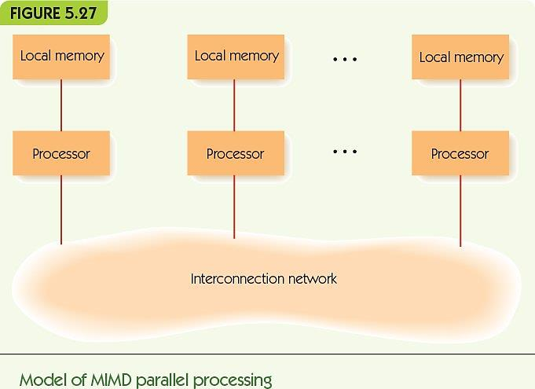
Non–Von Neumann Architectures (5 of 6)

Slide 52
Non–Von Neumann Architectures (6 of 6)
Varieties of MIMD systems
Special-purpose systems: newer supercomputers
Cluster computing: standard machines communicating over LAN or WAN
Grid computing: machines of varying power, over large distances/Internet
Examples
SETI project
BOINC at Berkley
Hot research area ► parallel algorithms
Need to take advantage of all this processing power

Slide 53
Summary (1 of 2)
We must abstract in order to manage system complexity—no more writing instructions in machine language.
Von Neumann architecture is standard for modern computing.
Von Neumann machines have memory, I/O, ALU, and control unit; programs are stored in memory; execution is sequential unless program says otherwise.
Memory is organized into addressable cells; data is fetched and stored based on MAR and MDR; uses decoder and fetch/store controller.

Slide 54
Summary (2 of 2)
Mass data storage is nonvolatile; disks store and fetch sectors of data stored in tracks.
I/O is slow, needs dedicated controller to free CPU.
ALU performs computations, moving data to/from dedicated registers.
Control unit fetches, decodes, and executes instructions; instructions are written in machine language.
Parallel processing architectures can perform multiple instructions at one time.

